Slide 1
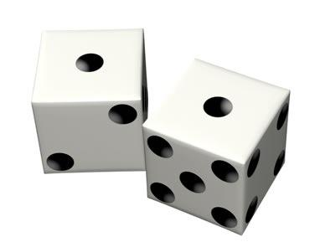
Mental set
When visiting a casino, the craps table is likely to be the most animated, loud and lively of the tables.
Craps is all about throwing dice and hoping they roll a number you're betting on.
The players take turn rolling two dice. The player that is rolling the dice is considered the shooter.
The shooter must roll a 7 or 11 on their first roll to win if they rolls a 2, 3, or 12 they lose.
If the shooter rolls a 4, 5, 6, 8, 9, or 10. This number becomes the point.
They must now roll the point to win before rolling a seven to win.
From hearing about this game which number do you thing is the easiest to roll with two dice?
Which numbers are the hardest?
Notes:
hook

Slide 2
Lesson objective
By the end of this lesson you will be able to;
- construct 2-way tables and calculate probabilities related to them.
Notes:
Lesson

Slide 3
24
7
30
Date
Title: Probabilities of combined events
EQ – What are two way tables and how are they used?
Many probability questions are concerned with combined events.
Combined events or Multiple events: When two experiments are conducted together and the results are considered as a combined event.
The simplest ways of considering combined events are by using two-way tables, Venn diagrams and tree diagrams.
Two-way tables are most useful for situations having two dimensions. Situations with two variables are of this kind for example rolling two dice or tossing two coins.
Notes:
Lesson objective (EQ)

Slide 4
Success Criteria
By the end of this lesson you will be able to construct 2-way tables and calculate probabilities related to them.

Slide 5
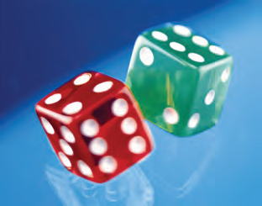
24
7
30
Date
Title: Probabilities of combined events
EQ – What are two way tables and how are they used?
Fill in the table below to represent two dice being thrown.
 | 1 | 2 | 3 | 4 | 5 | 6
1 | 2
2
3 |  |  |  |  | 8
4
5
6
Find the probability of obtaining two even numbers.
Find the probability of rolling 7.
Notes:
Input

Slide 6
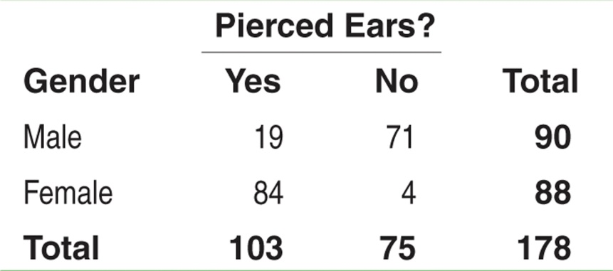
Consider the following table. Suppose we choose a student at random. Find the probability that the student
has pierced ears.
is a male with pierced ears.
is a male or has pierced ears.
(a) Each student is equally likely to be chosen. 103 students have pierced ears. So, P(pierced ears) = P(B) = 103/178.
(b) We want to find P(male and pierced ears), that is, P(A and B). Look at the intersection of the “Male” row and “Yes” column. There are 19 males with pierced ears. So, P(A and B) = 19/178.
(c) We want to find P(male or pierced ears), that is, P(A or B). There are 90 males in the class and 103 individuals with pierced ears. However, 19 males have pierced ears – don’t count them twice!
P(A or B) = (19 + 71 + 84)/178. So, P(A or B) = 174/178
Notes:
Input

Slide 7
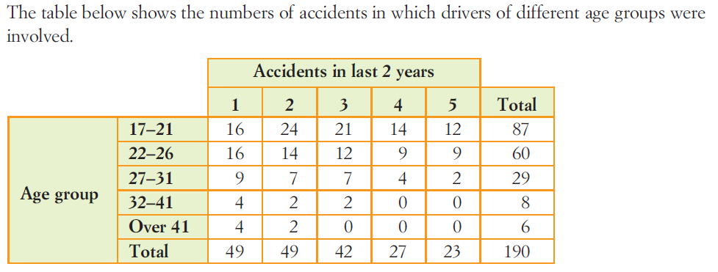
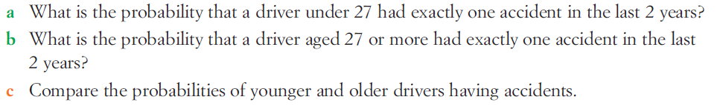
24
7
30
Date
Title: Probabilities of combined events
EQ – What are two way tables and how are they used?
Notes:
Input

Slide 8
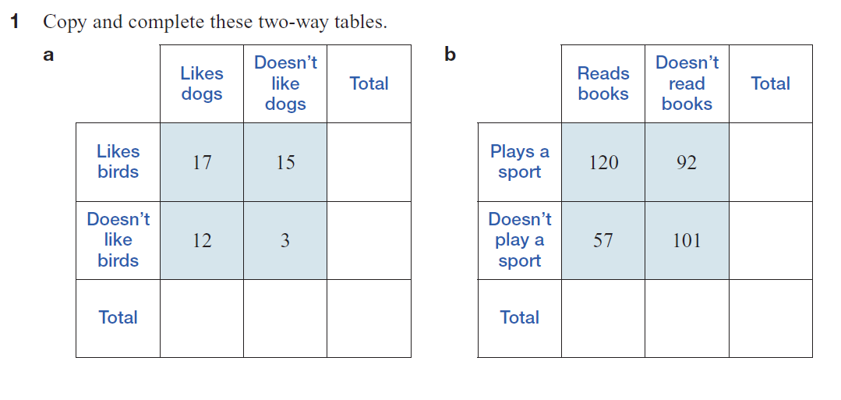
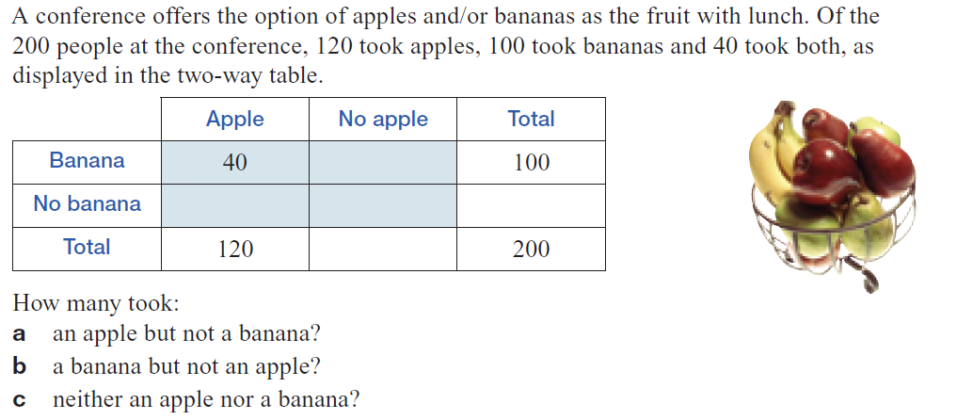
2
Notes:
Guided practice

Slide 9
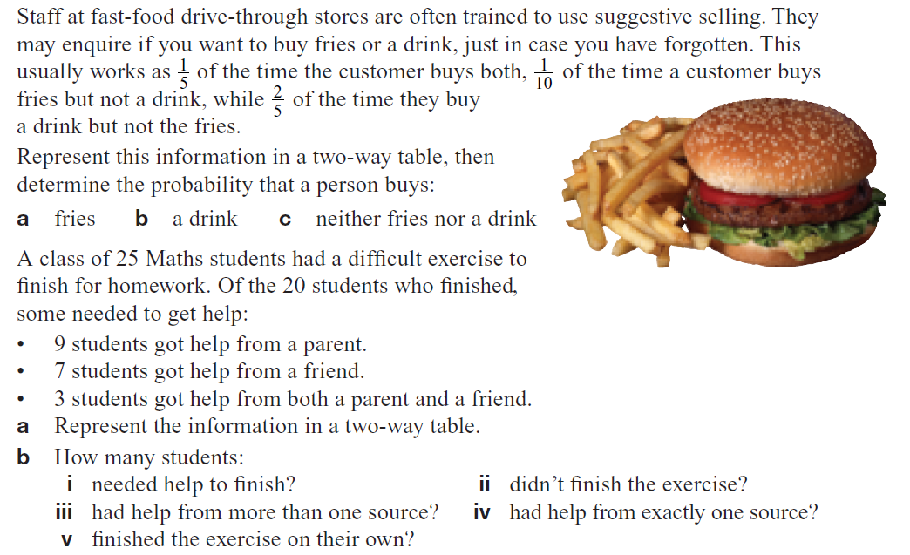
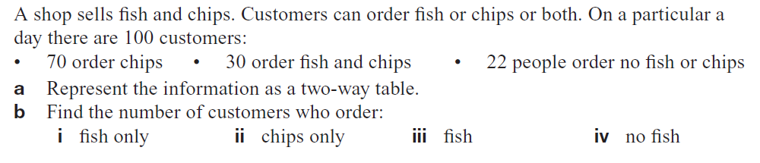
3
4
5

Slide 10
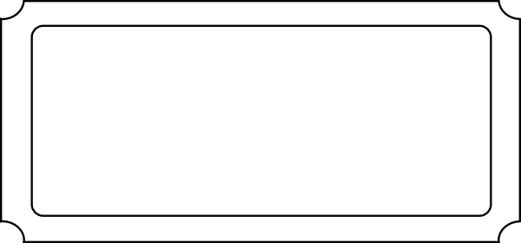
Exit Pass
Name ___________
Give an example of a combined event ________________________________
Draw a two table which show two dice being thrown ?
What is the probability of throwing a 7 ? __________
What is the probability of throwing a 12? __________
+

